Slide 1
Impact of weather & Socio-Eco factors on Covid-19
Muhammad Shakir Aleem
Supervisor: Obinna Izima
Student id : 10534253

Slide 2
Business objectives
Business Objectives:
Identify key features that could cause covid-19 spread to countries and organisations so that could plan better.
Predict covid-19 spread based on environmental factors.
Project Objectives:
Whether environmental factors impact covid-19 cases and death or not.
Can environmental factors predict daily covid-19 spread/death.
Assign labels(severity) to target variables and then try to predict whether environmental factors predict labels(severity).
Visualize socio-economic data to find out correlation between total covid-19 spread and factors of countries.
Hypothesis
Null hypothesis – No weather factor has influence on daily cases and deaths.
Alternative hypothesis – weather factor(s) has some influence on daily cases and deaths.

Slide 3
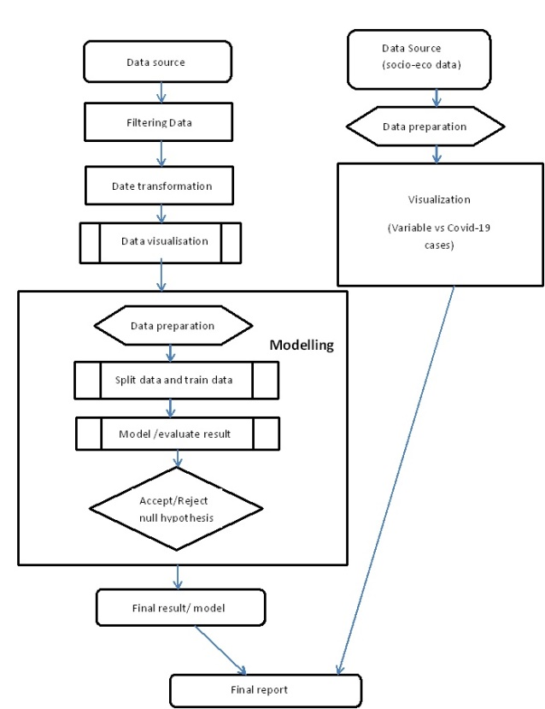
Process flow

Slide 4
Prediction models
Regression models
Multi-linear regression: To find the most correlated features and build prediction model.
Linear regression: Which environmental factors impact more on Covid-19 cases and deaths.
Lasso regression: Lasso also key to build predictive model and variables selection.
Classification models
Logistic regression: It is good model for labelled data. It is easier to implement, interpret, and very efficient to train.
Random Forest: low correlation decision tree to predict label variable. It is also efficient than decision tree. It can reduce overfitting, bias and overall variance.

Slide 5
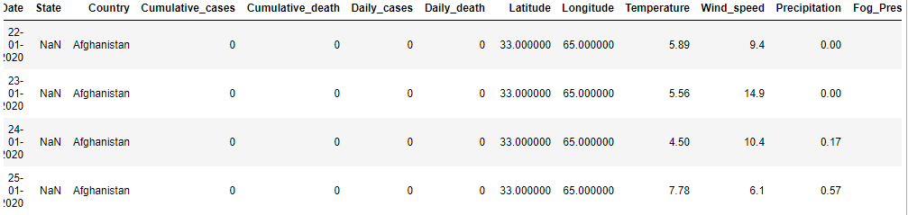
Dataset & data preparation
Original dataset
Dependent variables are “Daily_cases” and “Daily_death”.
Following features have been select for modelling:
Daily_cases, Daily_death, Latitude, Longitude, Temparature, Wind_speed, Precipitation, Fog_Presence

Slide 6
Dataset and Data preparation(cont.)
Date converted into Weekdays to visualized which day(s) of week reported more covid-19 cases/death.
Target variable “daily_cases” contains zero value. Those row contains zeros are filtered out.
Remove outliers: replace maximum values with second last maximum values.
Do log transform to make features normally distributed but it did not impact.

Slide 7
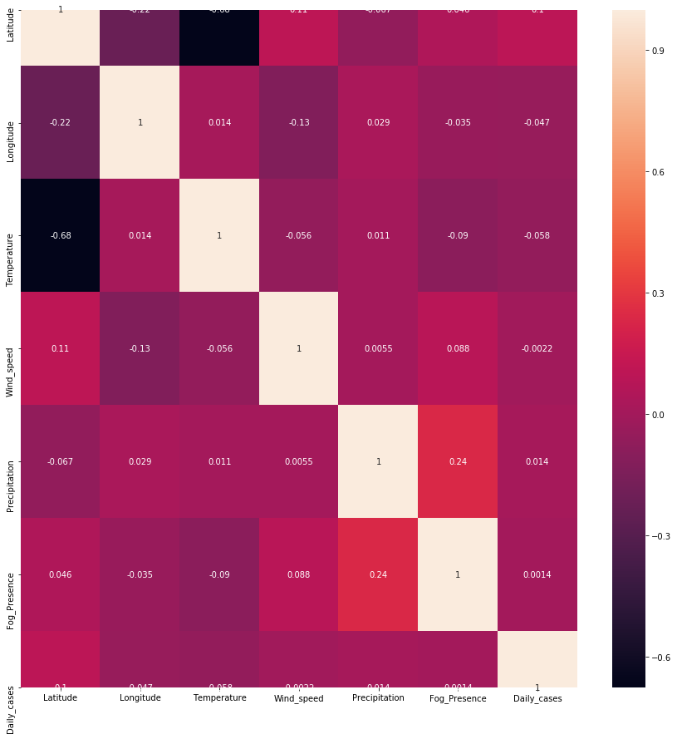
Heat Maps
Environmental factors vs daily cases
“Temperature” most inversely while “latitude” is most directly proportional to daily cases

Slide 8
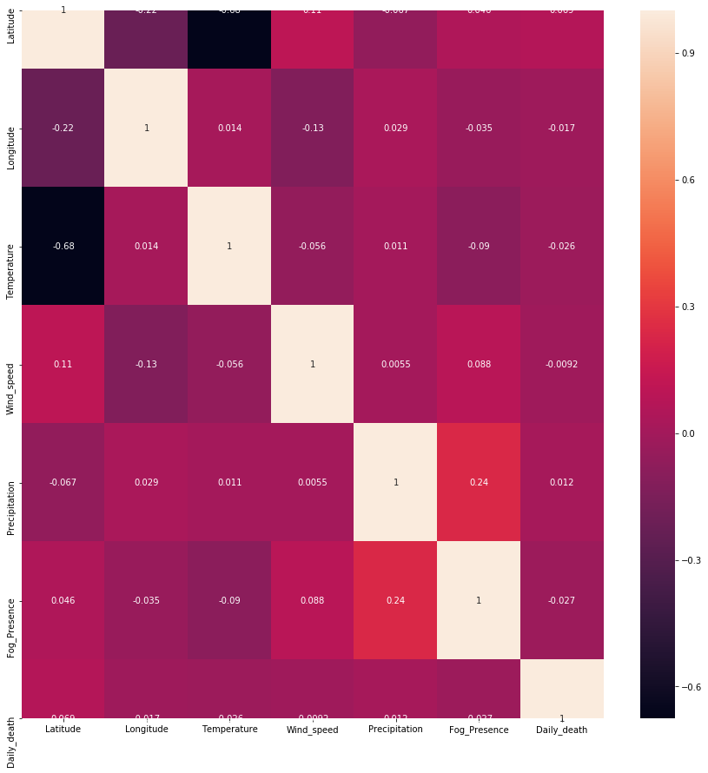
Heat Maps
Environmental factors vs daily death
“Fog_presence” most inversely while “latitude” is most directly proportional to daily cases

Slide 9
Data preparation for modelling
Model | Data prep method
Multi-linear regression | Log transformation MinMaxScaler
Linear regression | No scaling or standardization applied
LASSO | StandardScaler
Logistic regression | MinMaxScaler
Random forest | No scaling or standardization applied
List of standardization methods and models used for modelling.

Slide 10
Data preparation for modelling(Cont.)
Dataset divided into 70% and 30% for training and test sets.
Regression/Classification models are built for individual dependent variables.
For classification modelling, “High” and “Low” labels are applied to dependent variables.
For Daily_cases: count of cases above “1000” assigned “High” and lower than “1000” is assigned “Low”.
For Daily_death: count of deaths above “100” assigned “High” and lower than “100” is assigned “Low”.
For classification modelling, smote method is used to balance data as high counts were very low.

Slide 11
Regression modelling outcomes
Multi-linear regression
Target variable | Transformation method | Feature variable | P-values | VIF | Evaluation Score
Daily cases | Log transform | Latitude, Longitude, Precipitation, Temperature, Fog_Presence | 0.000, 0.000, 0.186, 0.378, 0.598 | 28.93, 45.78, 1.23, 46.50, 1.69 | 0.0129
Daily cases | MinMaxScaler | Latitude, Precipitation, Longitude, Wind_speed, Fog_Presence | 0.000, 0.003, 0.042, 0.158, 0.235 | 5, 1.16, 3.65, 3.09, 1.63 | 0.0055
Daily Death | Log transform | Latitude, Longitude, Precipitation, Fog_Presence Temperature, | 0.000, 0.012, 0.023, 0.039, 0.083 | 28.93, 45.78, 1.23, 1.69, 46.50, | 0.012
Daily Death | MinMaxScaler | Latitude, Precipitation, Fog_Presence Temperature, Wind_speed, | 0.000, 0.003, 0.013 0.146, 0.220, | 4.78, 1.16, 1.63, 4.33, 3.38 | 0.003

Slide 12
Regression modelling outcomes(Cont.)
Linear regression
Dependent variable | Score | Intercept
Daily cases | 0.0121 | 50.46510316
Daily death | 0.0072 | -0.01688669
Feature | Coefficients (daily cases) | Coefficients (death cases)
Latitude | 3.606 | 2.33347516e-01
Longitude | -0.288 | 2.81383458e-03
Temperature | 1.380 | 1.53265362e-01
Wind_speed | -3.510 | -1.52593421e-01
Precipitation | 101.715 | 2.85253703e+00
Fog_Presence | -21.125 | -4.68842488e+00
Error | Daily death error | Daily cases
MAE | 11.632046168505786 | 203.8356469550698
MSE | 1874.690015625511 | 242288.92083921688
MAE square | 3.410578568000712 | 14.277102190398084

Slide 13
Regression modelling outcomes(Cont.)
LASSO
Evaluation
Daily cases : Temperature and fog coefficients are less significant. The most significant features are “latitude” and “precipitation”.
Daily deaths: “Longitude” is not significant feature. The most significant features are “latitude” and “precipitation”.
Dependent variable | alpha | MAE | Standard Deviation | R-square
Daily cases | 3.612 | 199 | 36.21 | 0.010
Daily death | 0.001 | 13.046 | 3.174 | 0.005

Slide 14
Classification modelling outcomes
Logistic regression
Explained variance score for daily cases: -0.4507
Explained variance score for daily deaths : -0.1026
Random forest
For daily cases (feature importance): Longitude, latitude and temperature are significant features.
For daily death (feature importance): Latitude, longitude and temperature are significant features.
Dependent variable | Accuracy of train set | Accuracy of test set
Daily cases | 0.65 | 0.64
Daily death | 0.72 | 0.73
Dependent variable | Score | Explained variance score
Daily cases | 98.13 | 0.9252
Daily death | 98.91 | 0.9566

Slide 15
Social-economic factors vs Covid-19 cases
Second part of the project is to find correlation ship between Social economical factors and total Covid-19 cases to population ratio of countries.
Collected data of some countries which include following features. New column added in dataset which is ratio of covid-19 cases and population of each country
Socio-eco features | Correlation with Covid-19 ratio
Sex Ratio | -0.009264
Life Expectancy (F) | 0.014775
Age%_65+ | 0.026643
Median_Age | 0.040044
Life Expectancy (M) | 0.041933
Lung Patients (M) | 0.358871
Lung Patients (F) | 0.440292
Population | 0.939469

Slide 16
Conclusions
From regression analysis
Current dataset is not good enough to predict covid-19 cases/death by environmental factors.
Locations(latitude and longitude) and Precipitation are most significant factors of environment in Covid-19 spread.
Environmental factors are more correlated with daily cases as compare to daily death.
From classification analysis
Classification models are preforming well to predict whether specific weather condition cause high or low severity.
Similar to regression, classification also identified that location and temperature are key factors in high and low daily covid-19 cases/death.
Socio-Eco factors vs Covid-19
It is concluded from visualisation and correlation figures that Population and lung patients(M/F) are strongly linked with total Covid-19 cases.
Most less significant factors are sex ratio, life expectancy of female and percentage of age above 65.

Slide 17
Future works
Need dataset with large duration (not just 3 months data) and with more environmental factors.
Build confusion matrix for classification models.
Collect remaining countries’ social-eco data and run regression models

Slide 18
Question?

